Slide 1
Introduction to Machine Learning for Absolute Beginners

Slide 2
What is Machine Learning
Machine Learning is inferring knowledge form Data .
  What we lac in knowledge, we make up for in data
  Learning – Optimizing a performance criterion
    Using example data or past experience
    Have a model define with some parameter
      Learning – execute of program to optimize some mocel based on examples or paassed experience
  Type of Mchine Learning Models
    Predictive ( supervised learning)– Make predictions on the future
    Descriptive (unsupervised learning) – Gain knowledge from Data
      Sometimes only have input knowledge and no outputs
      Basket Analysis
      Potentially identify risk factor for prostate cancer based on factors
    Reinforcement Learning (Semi Unsupervised Learning)
      don’t have input data , but teach it the same way we would a predictive algorithm
  Based on the theory of statistics
    Making inference from a sample
  Machine Learhning Statistics
  Network / Graphs Model
  Weights Parameters
  Learning Fitting
  Supervised learing regression / classification
  Unsupervised learning density esstimation / clustering

Slide 3
Types and Applications of Machine Learning
Supervised Learning
  An algorithm transforms your inputs into outputs
  Inputs ( predictors or independent variable)
  Outputs ( responses or dependent variable)
  Optimises the parameters such that the approxiatmation is minimized
    Our estimate are close to possible to our members in the training set
  Example :
    Email Spam Detector
    Handwritten Digit Recognition
  Classification Algorithm
    Input → Algorithm → Class
      Qualitative Output
    Example Credit Scoring to predict whether the customer is low/high risk
      Output Either High Risk or Low Risk
    Tryping to produce a discrimiant
      A fucntion that separates the examples of different classes
      Example if income > 1 and savings > 2 then low-risk else high-risk
    Results
      Prediction
        Once we have the rule that fits the past data, wec an make correct predictions for novelties
      Predicting Proability
        P(Y|X)
          X are the customer attributes and Y is 0 or 1 for low or high risk
          P(Y-1 | X = x) = .8 : The customer has an 80% probability of being high-risk

Slide 4
Types and Applications of Machine Learning
    Pattern Recognition
      Examples : Optical Recognition, Face recognition, medical diagnosis, speech recognition
      Optical Character Recognition
    Knowledge Extraction
      Learning rules from data
      The rule is the discriminiant ( See previous page)
      Allows you to explain the data in a much simpier way by creating a discriminiatn
    Compression
      Fitting rule to data give the explanation that is simplier than the data requiring less memory to store
      Store the discrimient not the data that create it
        Example don’t store the 1000 tail flips , but the probabity of head/tail only
    Outlier Detection
      Findings that do not obey the rule and are excetpions
  Regression
    Input → Algorithm → Number
    Example User Card Price
      Inputs Brand, Year, Mileage and the output is the price of the car
    Function fitting
      Y = mx + b
      Could use a quadratic or polynomial
      More inputs then it becomes more complex
Unsupervised Learning
  Only have input data

Slide 5
Types and Applications of Machine Learning
  Goal find regularities in the input
    Assumption : Structure to the input space
    Called Density Estimation ( clustering )
      The input space is structured as a result patterns occur more often others
    Aim to find clusers or groupings of inputs
    Example Customer Data
      Provide compies with natural gruping of its customer
    Example Document Clusering
      Remove non informative words and create a bag of words
      Each document is an N-dimensional binary vector whose element is 1 if words I appear in the document
Reinforcement Learning
  Observations ( Inputs ) → Algorithm → Actions
  Output of the system is a seuqnece of Acitons
  The policy ( sequence of correct action s to reach the goal is what is important)
    Example :Game playing
      The one move is not import, but winning the game is
      Games are easy to describe , diffucult to play
      Example Chess or Go
    Example
      Robot Navigation
      One more is not important as long as it reaches it goal
  Open AI Gym

Slide 6
Artifical Intelligence vs Machine Learning
Artifical Intelligence
  Theory and development of computer systems able to perform tasks that normally require human intelligence
Machine Learning
  A subset of Artifical Intelligence
  Data is the essential part of machine learning
    Learn from pass experience
    Gather information from the data ( eg. clustering)
What ML is not
  Machine Learning is not logic ( rule satisfaction )
  Not Artificial Intelligence since it does not have an understanding of the world.
  Not biology and/or neuro science

Slide 7
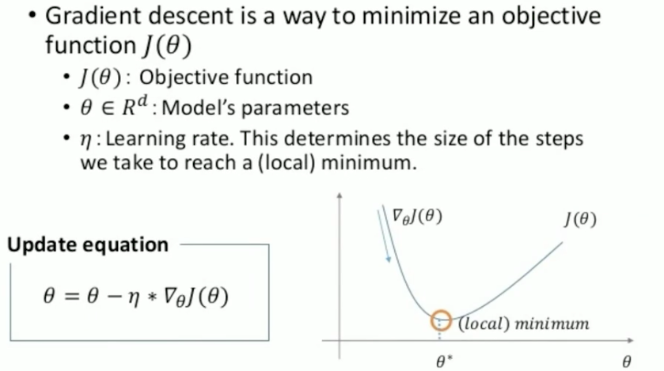
Essential Math for AI and ML
Multivariate Calculus
  Best mechanism for talking about smooth changes algebraically
    Optimization Problems Minimze the area using derivites and gradiants
    Probbability Measurement
      Integration is used to solve continuous probability density functions
      Find the total probability by integrating over the range
        Integrate over whole range and the probability is 100%
Optimization via Graident Descent

Slide 8
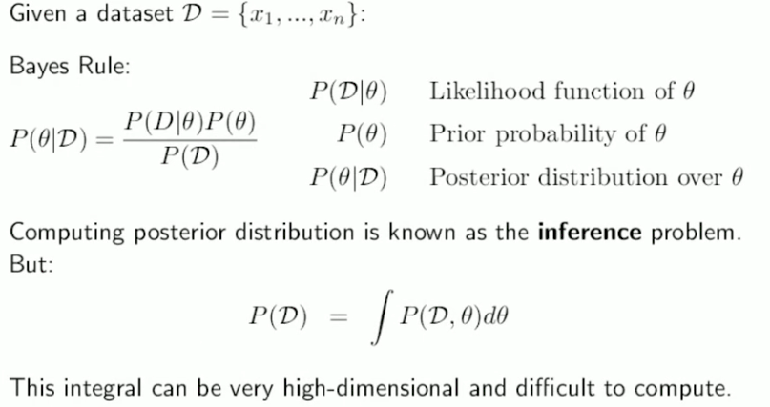
Essential Math for AI and ML
Explamation of previous figure
  Train model to optimize parameters
  Objective Function will be your error over the models parameters
  Trying to find a local derivitive
  Becomress much more diffucult whne you have many parameters
Bayesian Inference
  A mehtod of statical inference in which Bayes’ theorm I s used to update the probability for a hypothesisi as more evidence or information becomes available

Slide 9
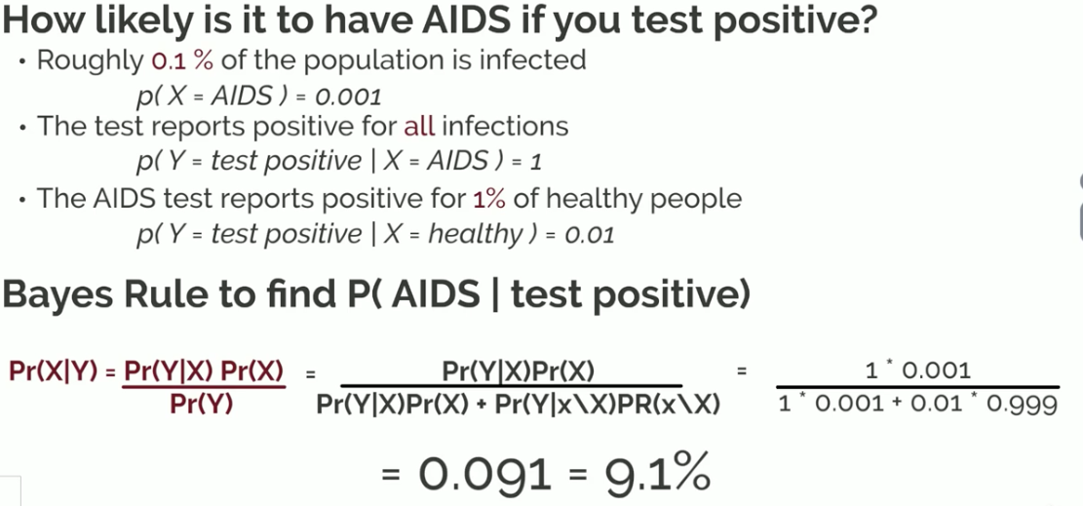
Essential Math for AI and ML
We need statistics to deal with uncertain events
  Most of the time the robability could be counter intuitive
Mathmatical formulations for probability ( Ex. Bayes Theorm
Estimate probabilities from data
Bayes Rule – Dependance and conditional probability
  Knowing x will tell us somehting about Y
    Knowing previous data will tell us something about the future
  Pr(Y|X) Pr(X) = Pr(Y,X) = Pr(X|Y) Pr*(Y) by using algerbra Basyes Rule Pr(X|Y) Pr(X) / Pr(Y)
Bayes Rule Example

Slide 10
Essential Math for AI and ML
Bay Theorm Continue
  Follow up to the previous test
  The secon test reports positive from 90% of infections and reports for 5% healthy people
  Math
    (.01 * .05 .9999)/(.01 *.05 *.9999+ 1 * .09 * .001)
    Answer 35.7 %
  Conclusion
    Adding extra observations can improve the confidence of the test considerably
Dependence is what we exploit for estimation ( Leads to Bayes Rule)

Slide 11
Essential Math for AI and ML
Describe coordindates and interactions of planes in higher dimensinos and perform opations on them
As you add inputs you get into higher dimension
  4 inputs means 4 dimensions
Why Linear Algebra
  Foundation field form matrices and vectors
    Inputs matrices and vectors : outputs usually matrices and vectors
  High Dimensional Representation
  Linear Operatins on Data Notation
Notation line algebra notation is essential to understanding the algorithm structure references in papers, books and websites
Operations Adding, Multiplying, inverting and traposing matrices and vectors

Slide 12
Introduction to Supervised Learning`
Inferring a function from labeled training data
Example Learng Class © of a family car
  Training Positive Example ( Family Cars, SUV, High Safety Rating) N gative Race Car, Motocycle
  Representation
    Two Attributes ( Price, Engin Power) are the inputs to the class recogniser
      X = x1, x2] Column vector of X the wtwo attributes / R = { 1 if x is a positive example, x is a negative example
    Each car is represented by an order pair ( x, r) and the training set contains N such examples
    X = { x, r } where 0 < t > N ( ti is an index into the x and r
    Hypothesis class : ( p1 <= price < p2) and ( e1 <= engine power <= e2)
      If the values fall with this range it is a family car
      We do not know the specific parameters yet
    The training data is plotted in 2D Space where it coordinates are Attributes ( x1, x2) and its type is given by R
      We have a shaded box that show the hypothesis class
      Don’t know the values of e1 and e2, p1 and p2
      Use the hypothesis class to find the values → Parameters are not know until we train the algorithm
    This is called input space
  More data sets will be better accuracy
  Empirical Error is the proprotation of training instances where predictions by out hypothesis h(x) do not match the required values ginven input X
    E( h | X) = Summation of t o N for the equation 1(h(x index t() != r indexed t)
    At the end have the values so that its includes all the positive example and none of the negative examples
    This is what we are trying to minimize
  Use gradient descent to find a local mininium to find a local minimum

Slide 13
Introduction to Supervised Learning`
Additional Terminology
  Generalization → How well our hypothesis will correctly classify future example that are not part of the training set
  Overfit → Do very well with the test data, but do not do very well new data
  Most Specific Hypothesis → The tightest rectangle that includes all of the positive examples and none of the negative examples
  Most General Hypothesis → The largesst rectangle that includes all the positive example and none of the negative examples
  Doubt – A case that falls inbetween the most specif hypothesis and the most general hypotesis
    With a case of doubt → Sometime don’t class ify the data point , but return it tot the user to make a determination

